Slide 1
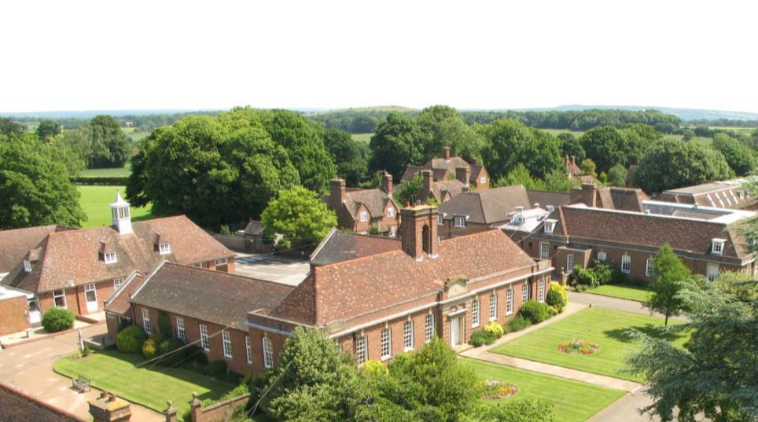
Wimbledon School of English Juniors Indirizzo Inghilterra

Slide 2
What Makes WSE Juniors Special?
Wide range of Specialist Skills Workshops
LWC: Outstanding sports and leisure activities
Challenging Young Leaders programmes
Safe, self-contained campus or host families near school
The WSE junior programme is more than just General English
Beautiful locations In Wimbledon or Hampshire
Amazing excursions
Make friends with people from all over the world

Slide 3
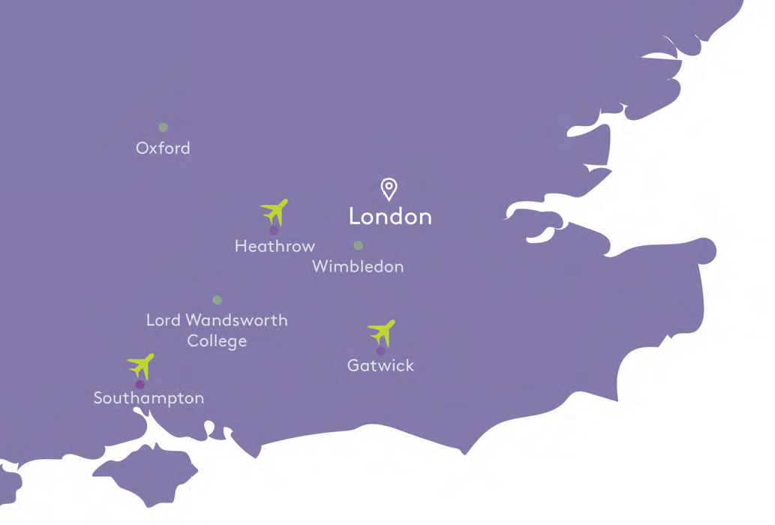
Location
Lord Wandsworth College is located in Hampshire, 1 hour from Wimbledon
Perfectly located for exploring London
and the South of England

Slide 4
2019 Nationality Mix
32 Different Nationalities
Italy (23%)
France (13%)
Spain (11%)
Russia (10%)
Poland (9%)
Slovakia (5%)
Germany (4%)
Serbia (4%)
Lao PDR (3%)
Turkey (2%)
Number of Students - 229

Slide 5
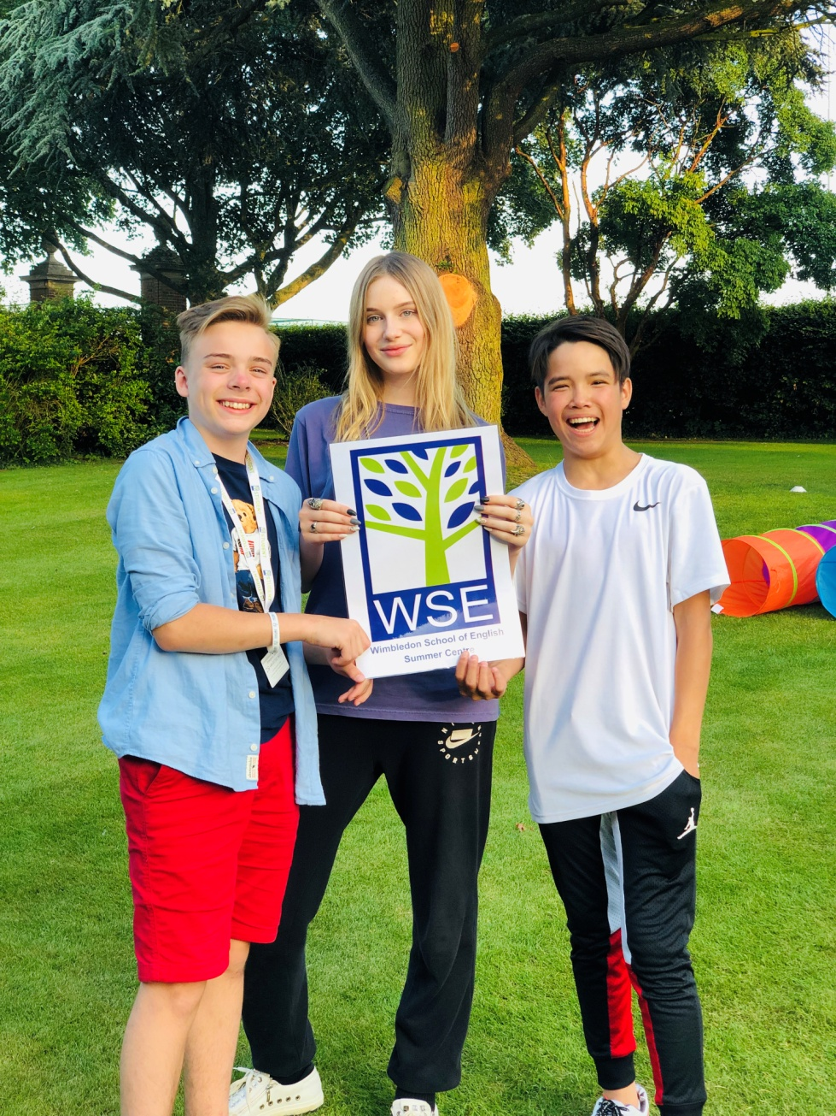
WSE Juniors at Lord Wandsworth College
Key Facts
Age: 10-13 and 14-17
Location: Lord Wandsworth College, Hampshire
Dates: 11th July – 14th August 2021
Accommodation: Boarding houses
Arrival: Sunday
Departure: Saturday
Capacity: 180 students
Tuition: 18 hours
Excursions: 2-3 per week Optional Sports Academies: Tennis coaching, horse riding

Slide 6
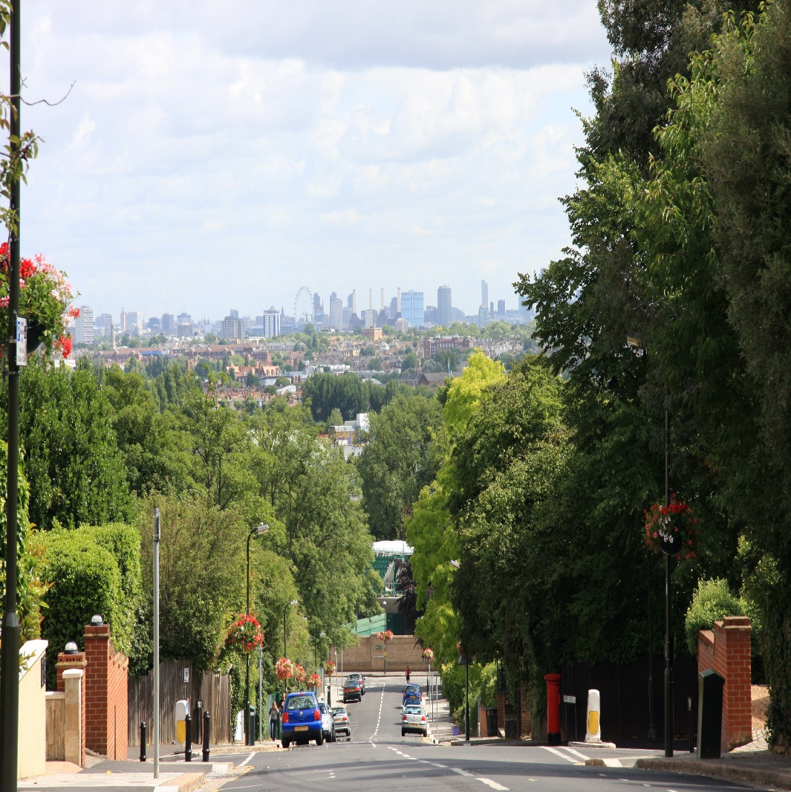
WSE Juniors in Wimbledon
Key Facts
Age: 12-17
Location: Wimbledon School of English, London
Dates: 20th June – 21st August 2021
Course Length: Minimum 1 week
Accommodation: Homestay or own accom
Arrival & Departure: Sunday
Course Start Day: Monday
Capacity: 100 students
Tuition: 15 hours
Excursions: 4 Central London excursions, one evening out and 1 full-day excursion every week
Optional Sports Academies: Tennis

Slide 7
Courses
General English + Specialist Skills Workshops
Or
Young Leaders (age 14+) + Specialist Skills Workshops

Slide 8
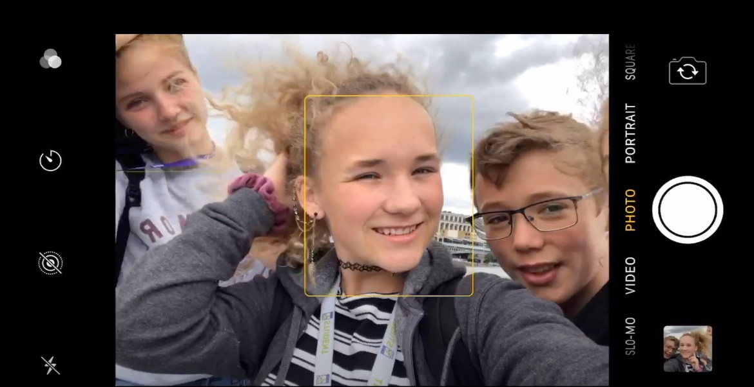
Courses
Specialist Skills Workshops
English for Gamers – NEW (LWC only)
Football Academy – NEW (LWC only)
University Preparation
British Youth Culture (LWC only)
Debating, Presentations & Public Speaking
Film Making and Social Media
Junior Journalist

Slide 9
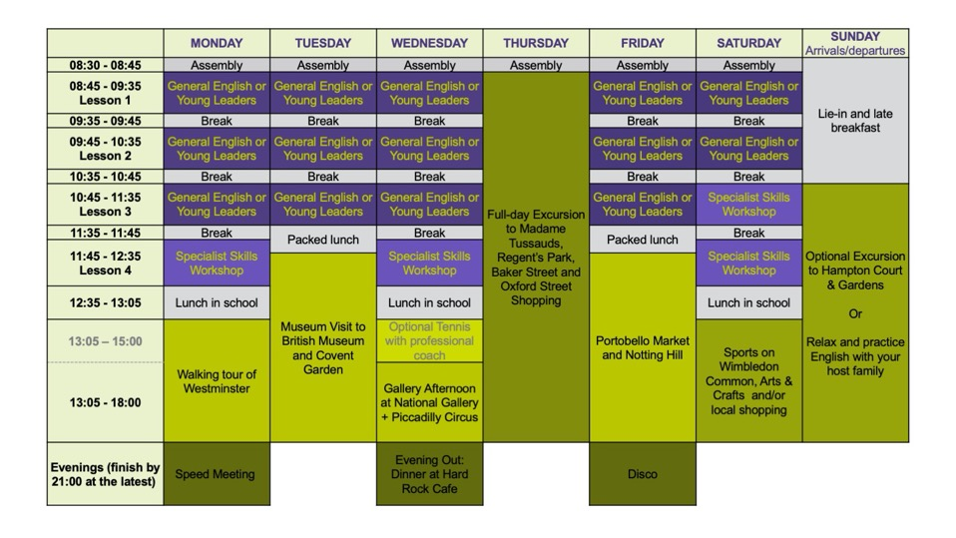
Juniors in Wimbledon Timetable

Slide 10
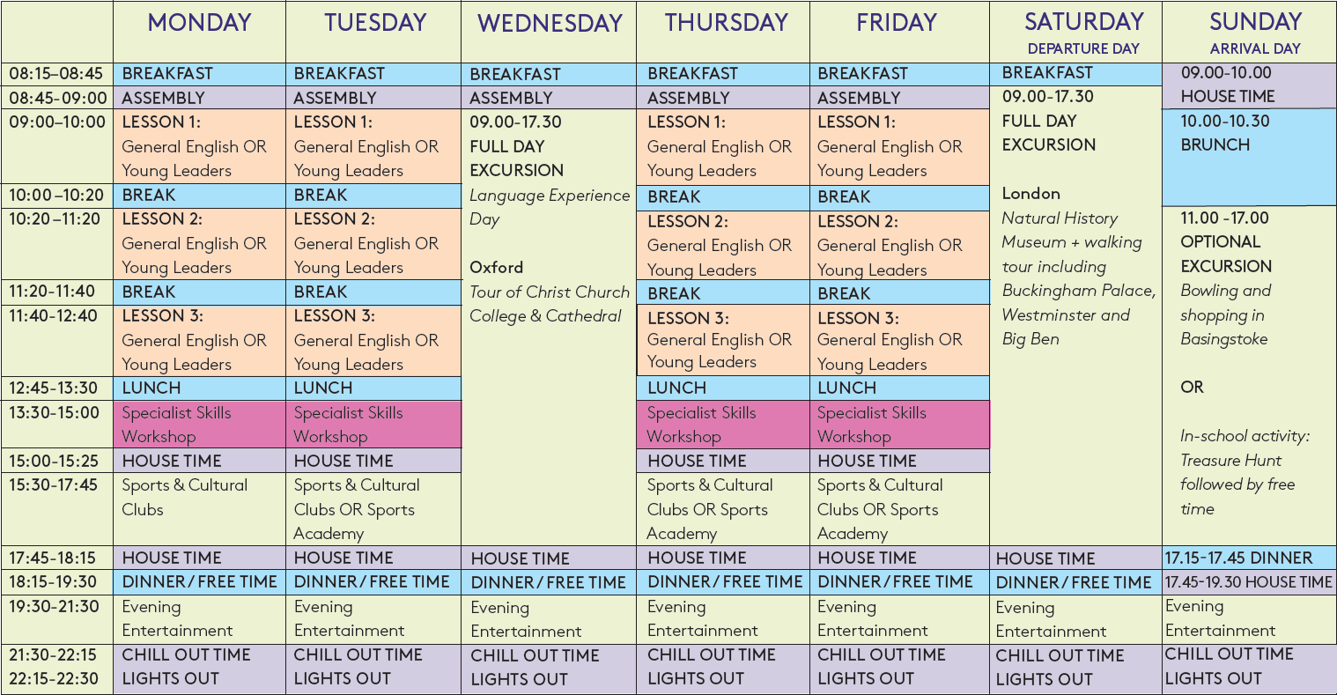
Lord Wandsworth College Timetable

Slide 11
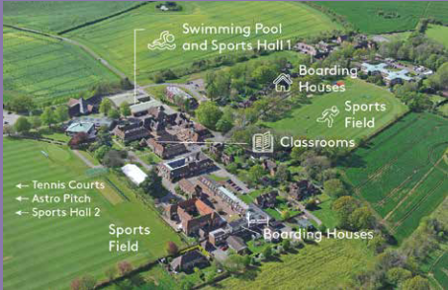
Lord Wandsworth College

Slide 12
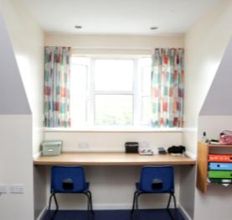
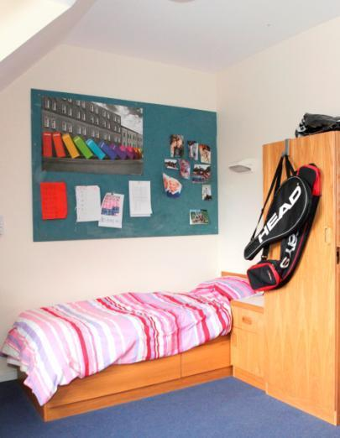
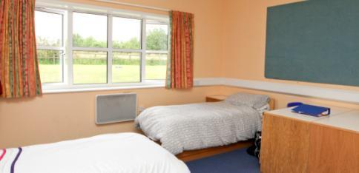
LWC Boarding Houses

Slide 13
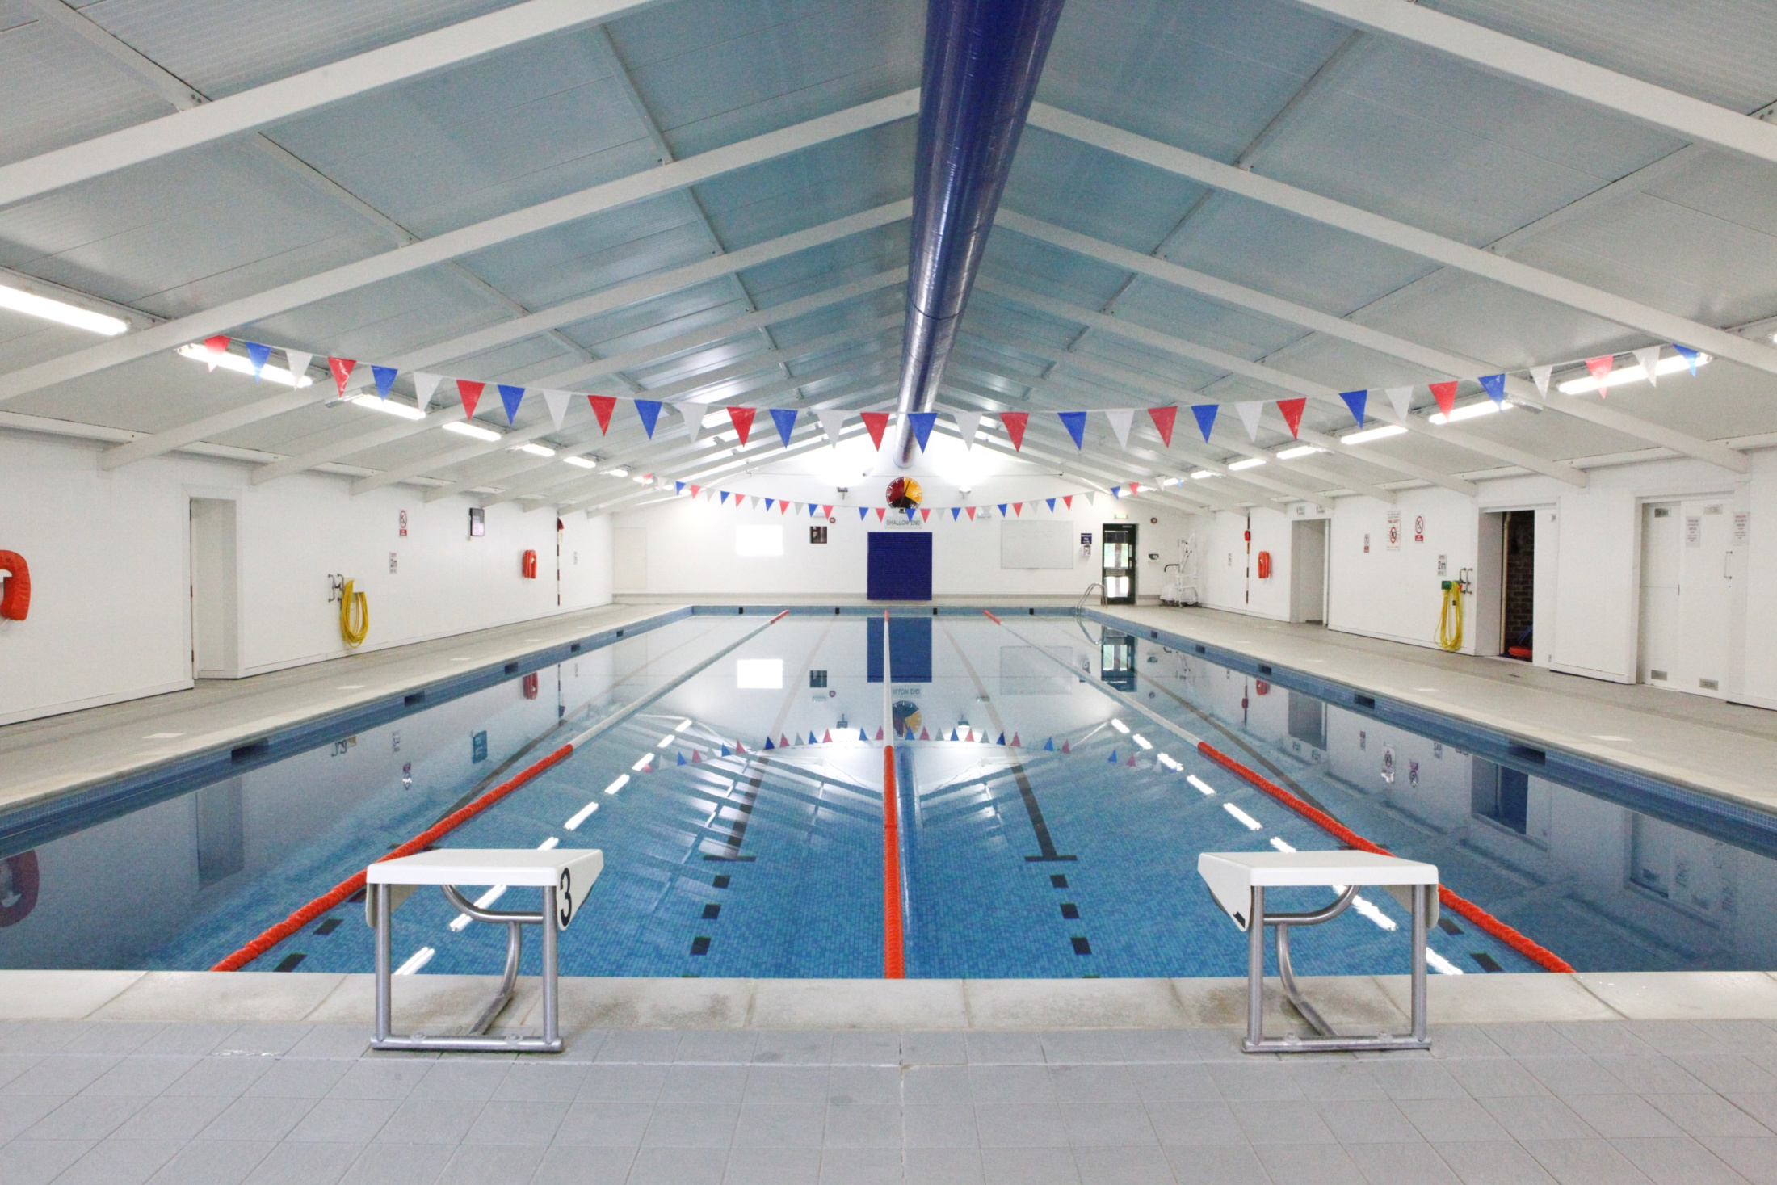
LWC Activity Programme
Sports
Football
Tennis
Basketball
Volleyball
Swimming
Badminton
Tag rugby
Rounders
Table Tennis
Dance & Fitness

Slide 14
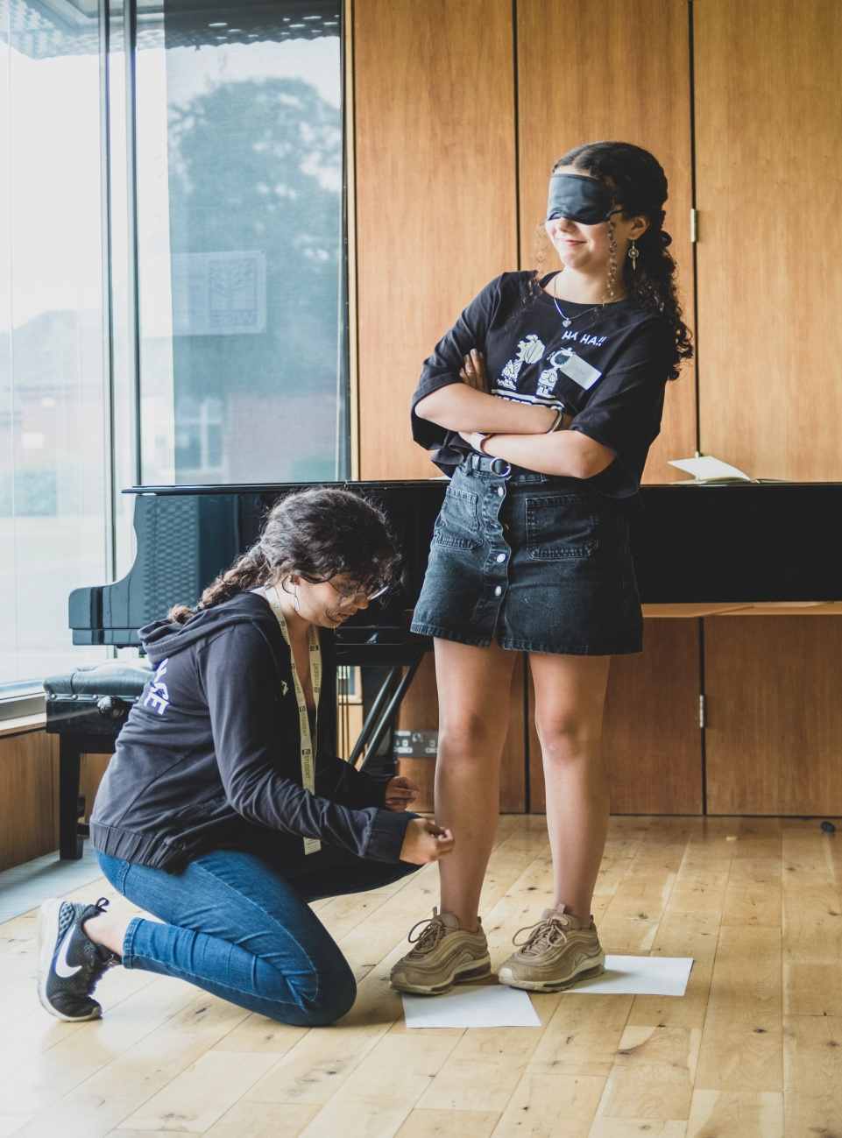
LWC Activity Programme
Non-sporting Activities
Arts and Crafts - Mask Decorating, Henna Tattoos, Dream Catcher Making, Painting to Music & more. Nature Discovery – explore the beautiful campus and learn some survival skills WSE Junior Choir – raise your voice & practise your English through song Drama Workshop – have fun acting out short drama sketches Cookery Club – Make and then eat goodies such as fridge cakes & thumb-print cookies
Board Games Club – sharpen your brain by playing Chess, Backgammon etc

Slide 15
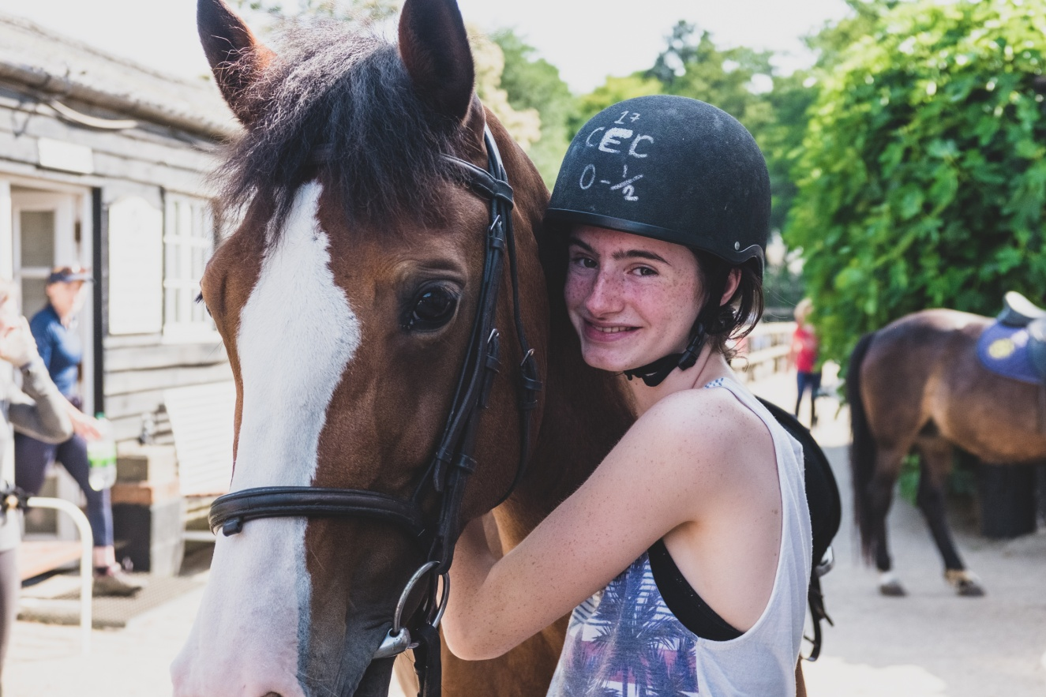
Optional Sports Academies
Sports Academies
Students also have the opportunity to focus on just one sport by selecting one of our optional sports academies. There is an additional cost for these activities which are instead of the afternoon group activities.
Horse Riding (LWC only)
Tennis Coaching

Slide 16
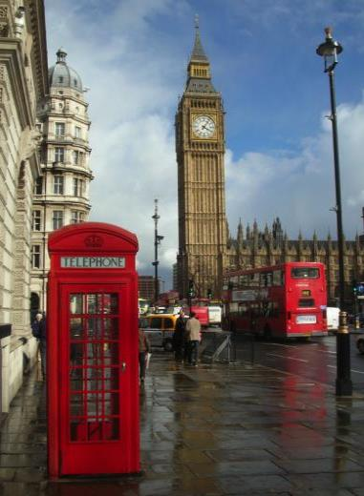
Excursions
Have fun while learning about British culture!
3 excursions per week - Wednesday 09:00 – 17:30 (language experience)
- Saturday 09:00 – 17:30
Sunday 11:15 – 17:30 (optional, extra charge)
Sample Excursions
London
Oxford
Windsor
Stonehenge and Bath
Thorpe Park
Harry Potter Studios

Slide 17
Wimbledon School of English Juniors
Indirizzo Inghilterra – contattarci per preventive e prenotazioni
070 7265121 – info@indirizzoinghilterra.it

