Slide 1

Job Opportunities
Near Linguaviva (Dublin) in November 2021

Slide 2

We have put together this list of businesses situated within walking distance of The Linguaviva Centre, ALL of which are advertising part time positions ideal for students. There is a variety of work currently available and we hope this information helps our Long-Term, Stamp 2 Students find a job nearby and therefore make
Studying + Working in Dublin much easier!

Slide 3
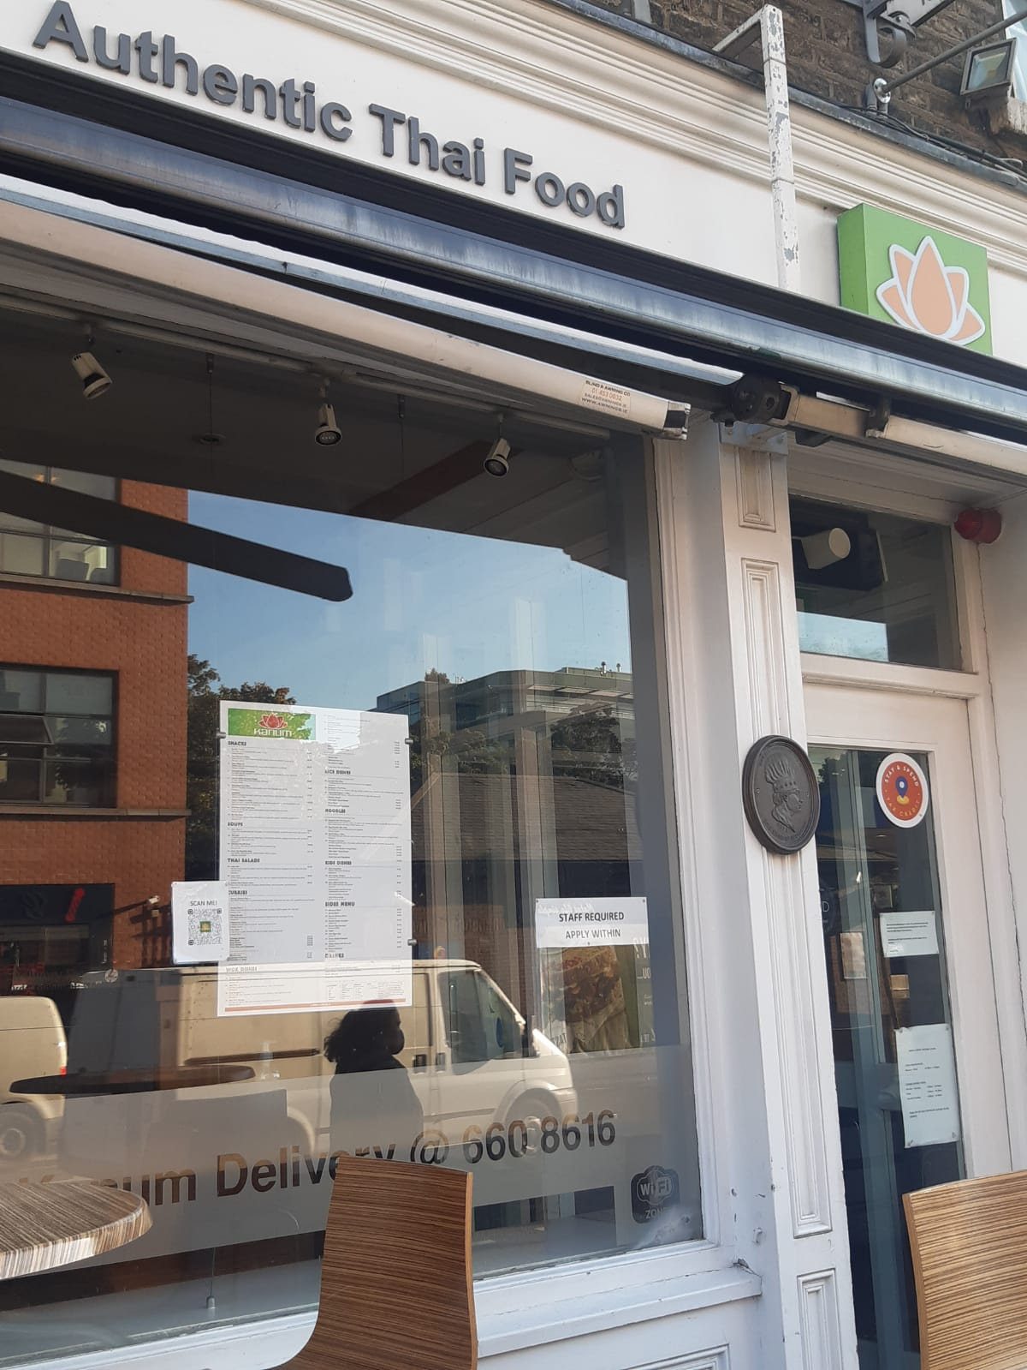
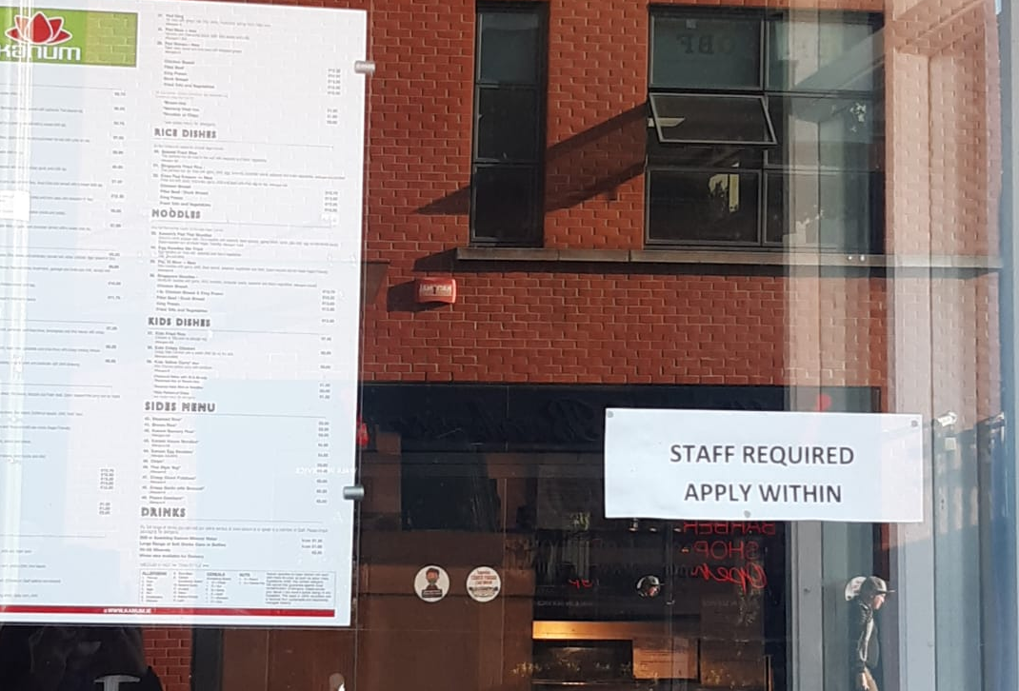
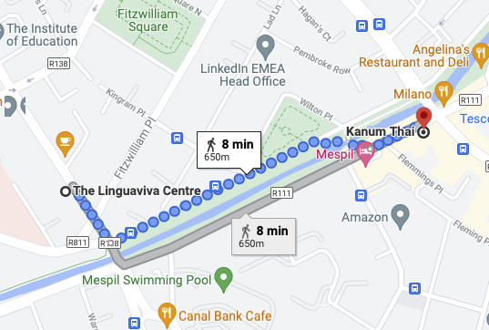
KANUM THAI
77 Mespil Rd, Dublin 4,
D04 VN26, Ireland
+353 1 6608616

Slide 4
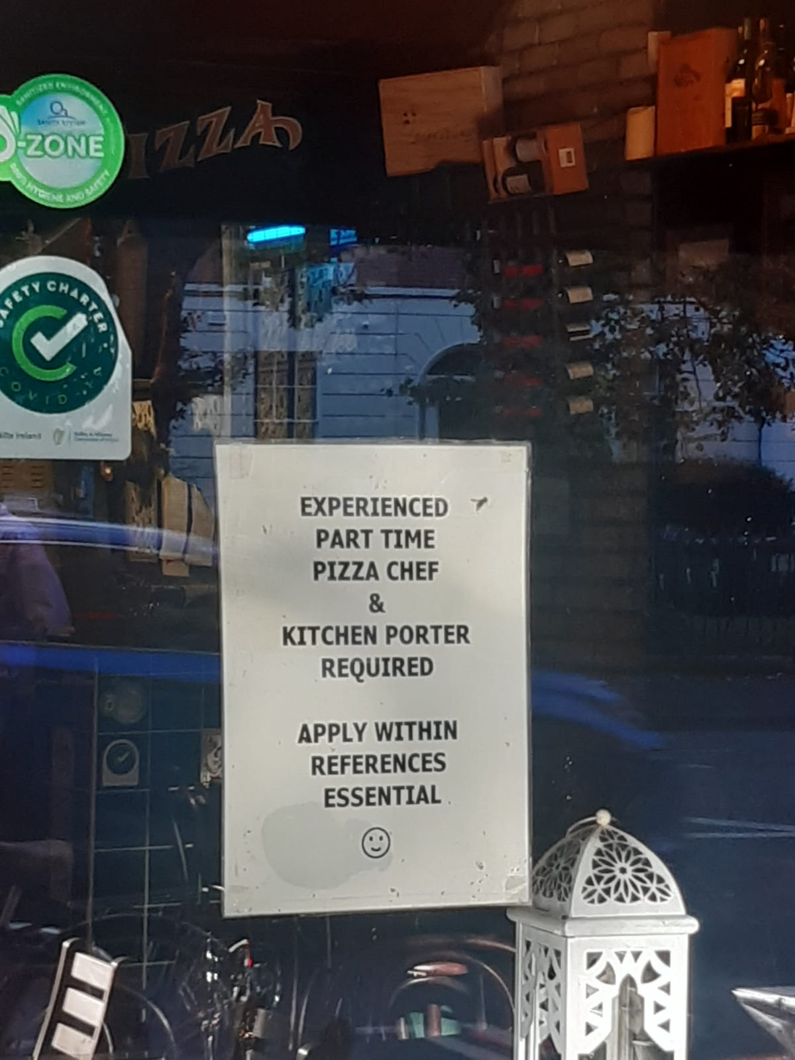
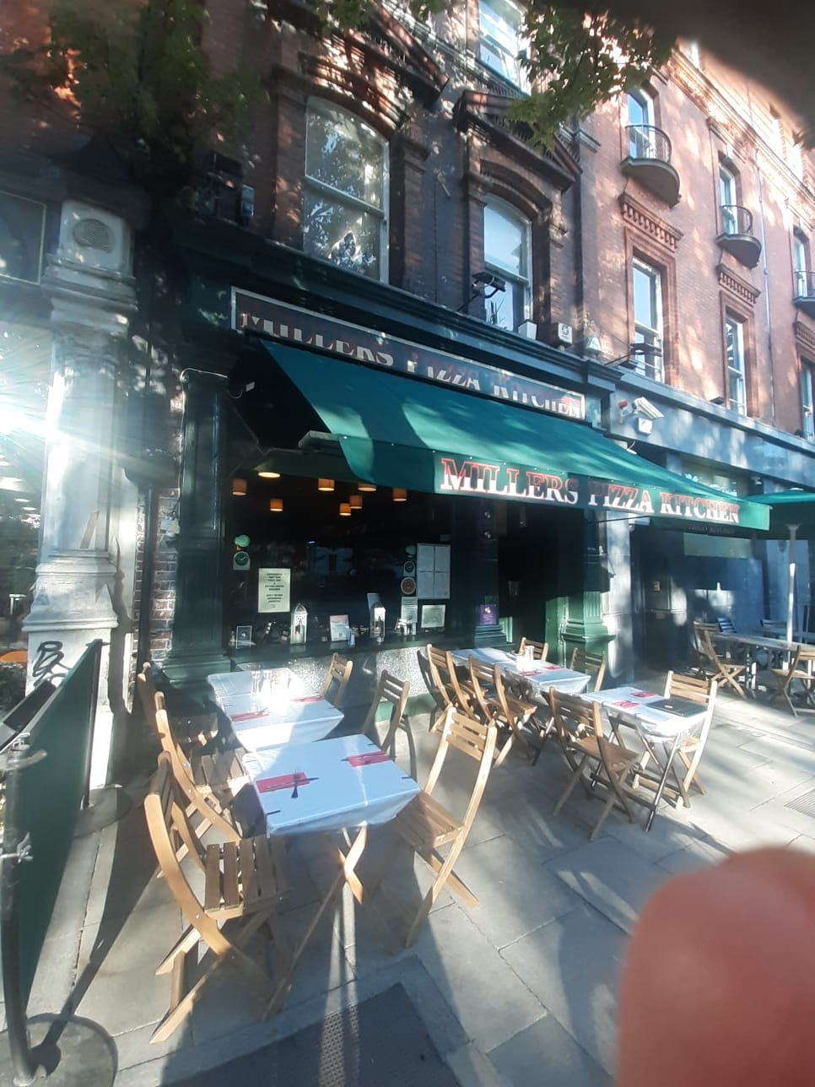
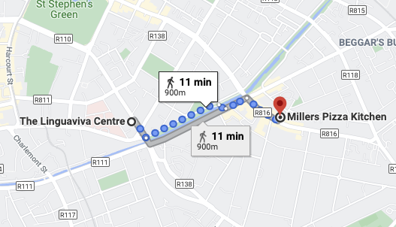
MILLERS PIZZA KITCHEN
50 Baggot Street Upper, Dublin 4, D04 DH31
+353 1 6606022

Slide 5
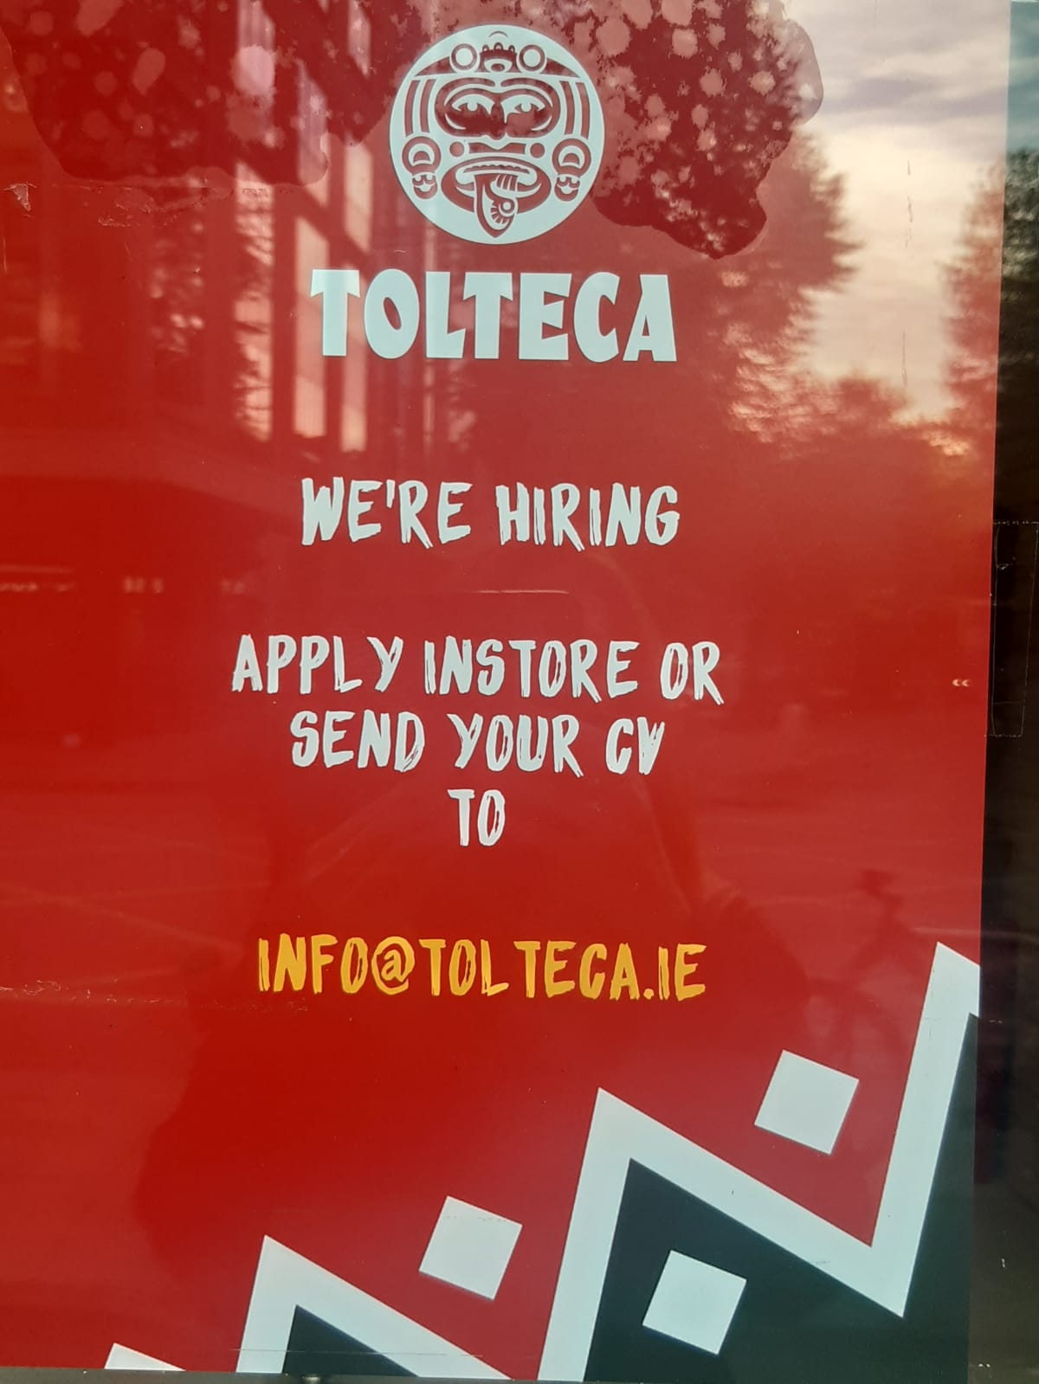
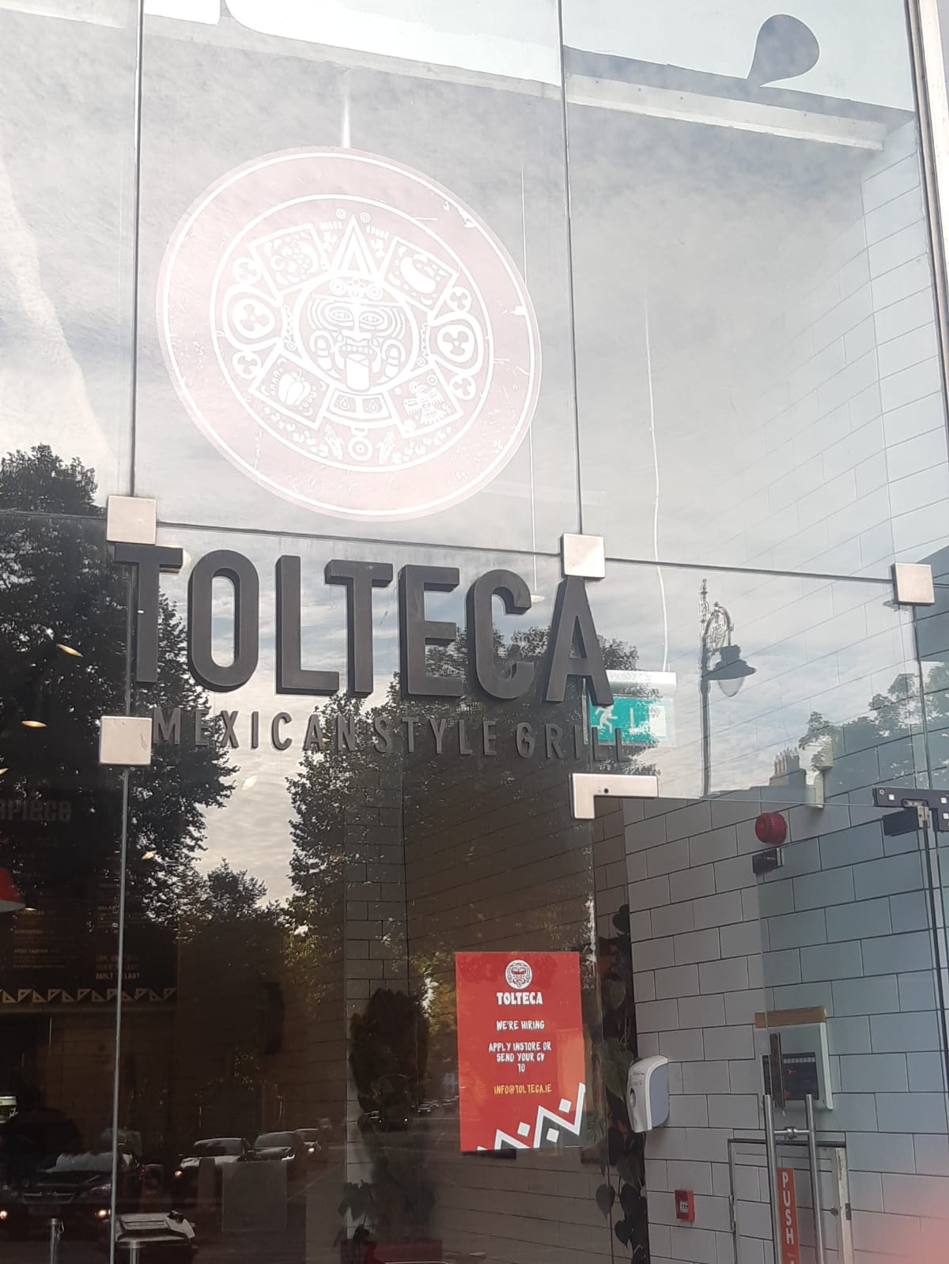
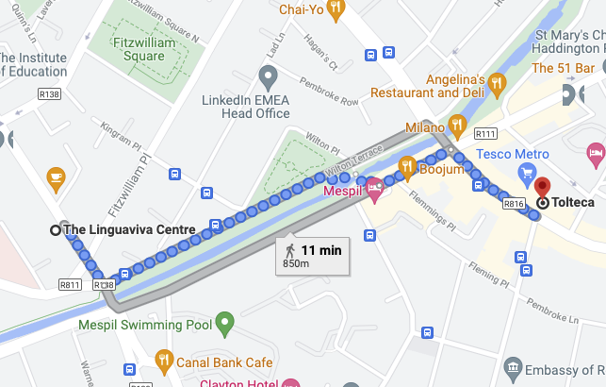
TOLTECA
38 Baggot Street Upper, Ballsbridge, Dublin 4,
+353 1 6688604

Slide 6
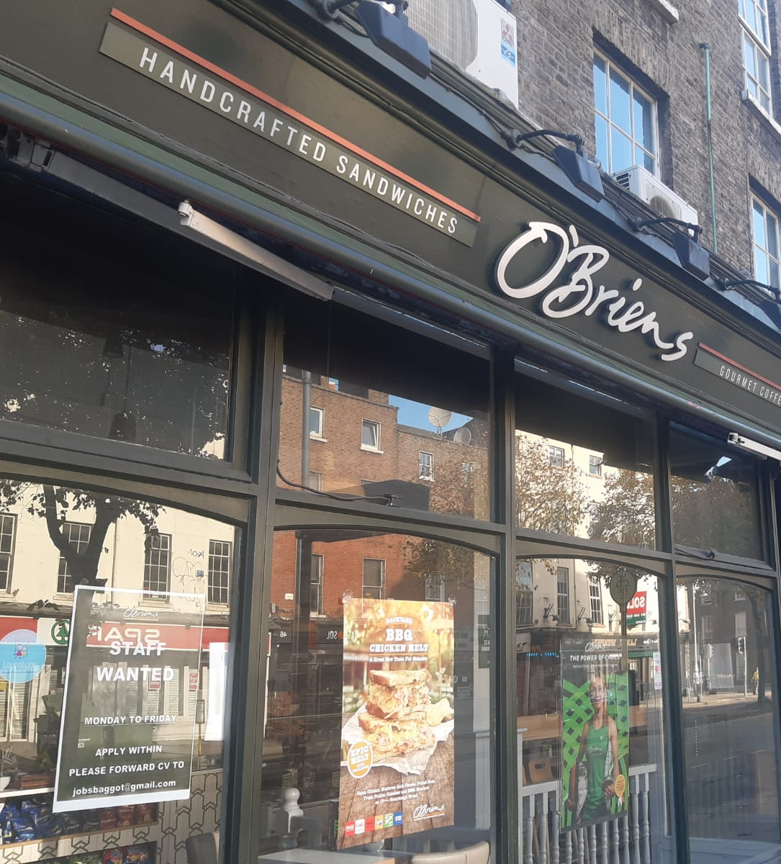
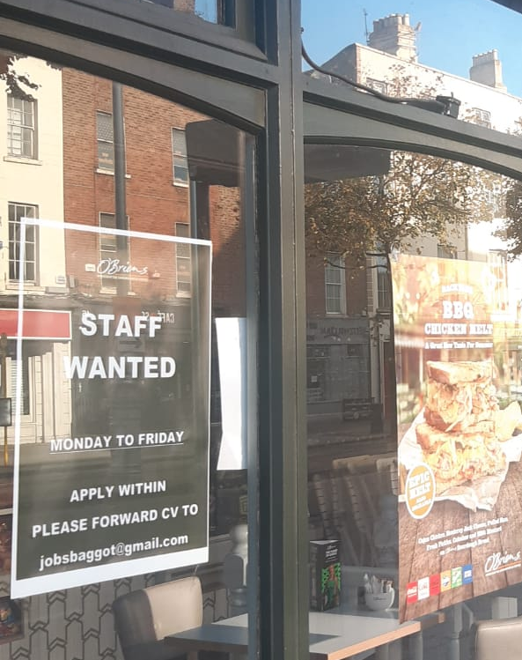
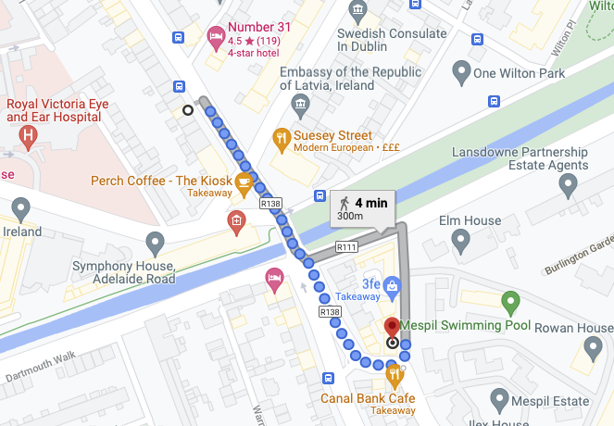
O’BRIEN’S
8-9 Sussex Terrace,
Dublin 4, D04 KN82
+353 1 6762851

Slide 7
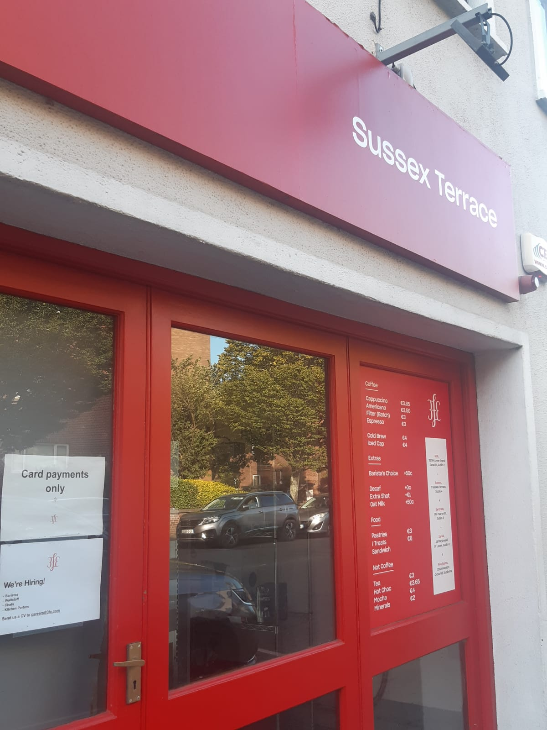
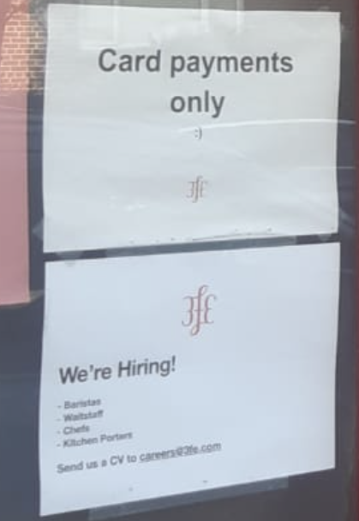
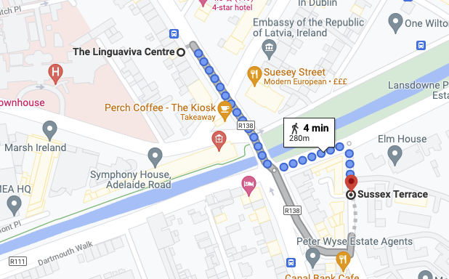
SUSSEX TERRACE
8/9 Sussex Terrace,
Leeson Street Upper,
Dublin 4, D04 KN82

Slide 8
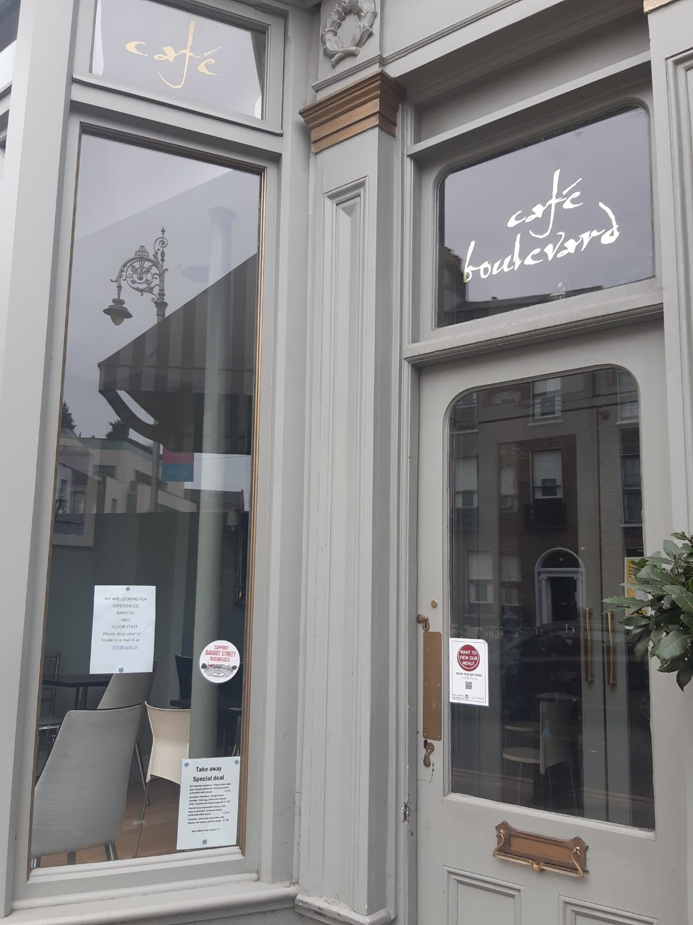
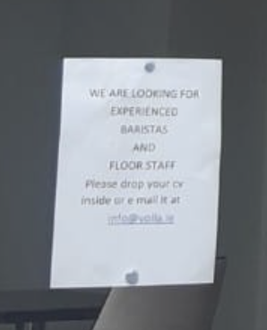
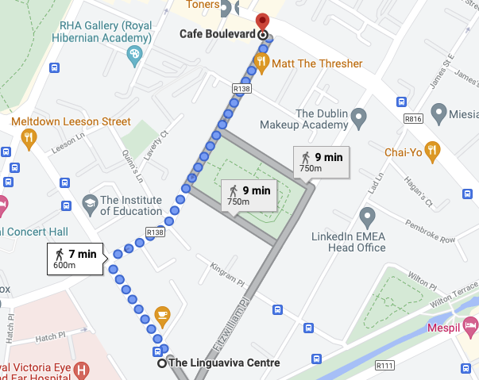
CAFE BOULEVARD
132 Baggot Street Lower, Dublin, D02 AE12
+353 1 6787054

Slide 9
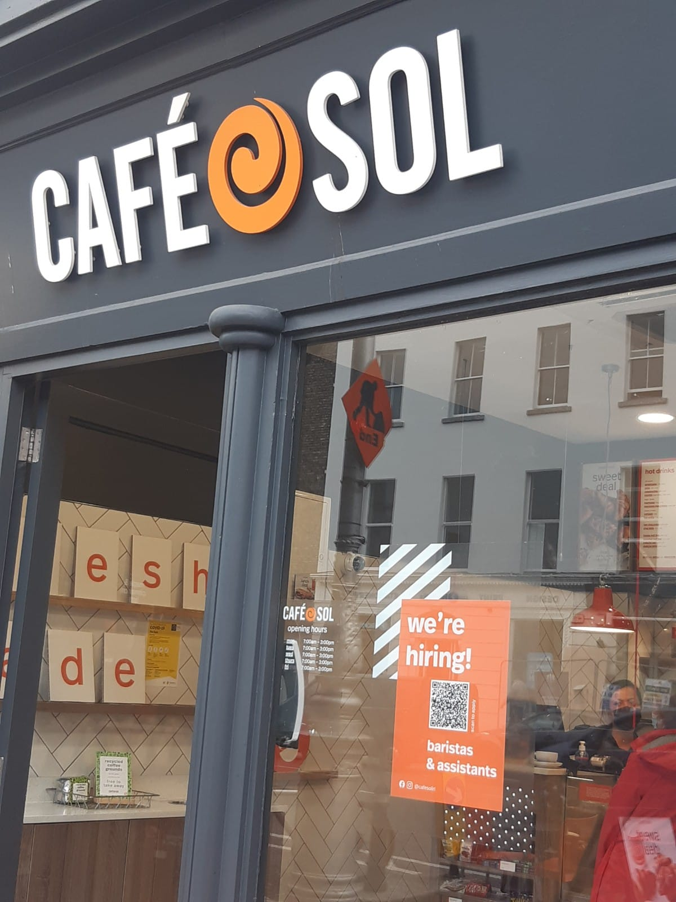
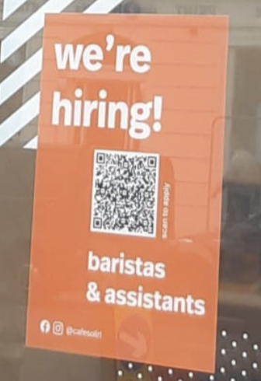
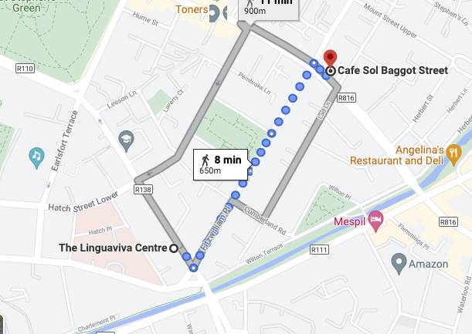
CAFE SOL
46 Baggot Street Lower, Dublin, D02 RP48
+353 1 6628037

Slide 10
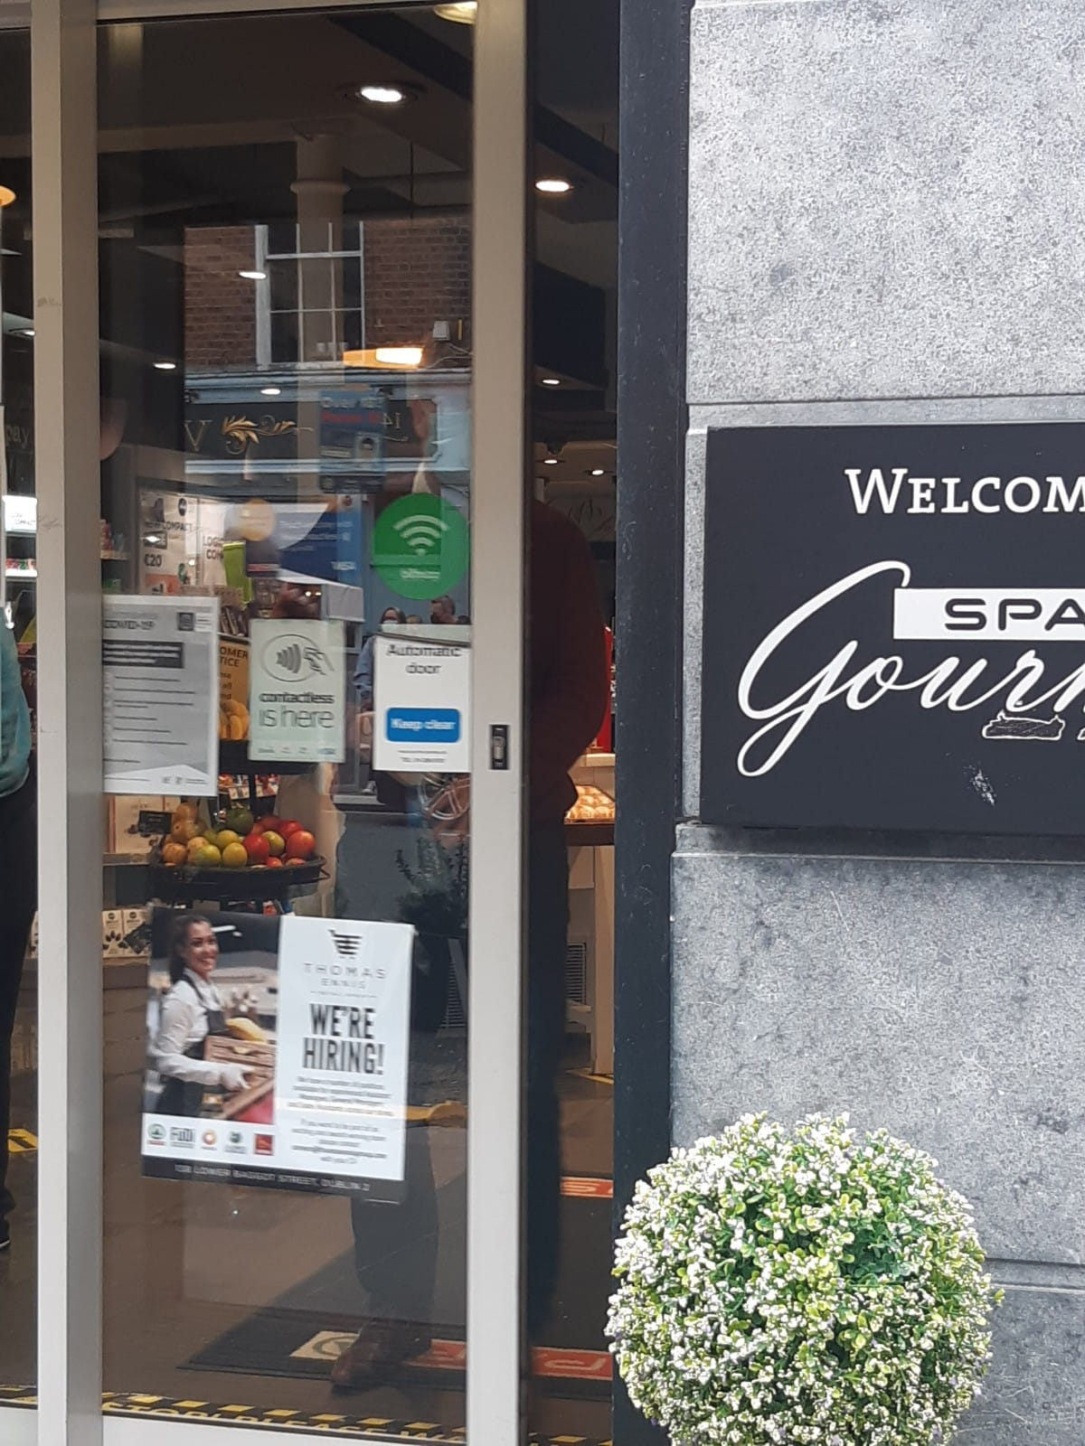
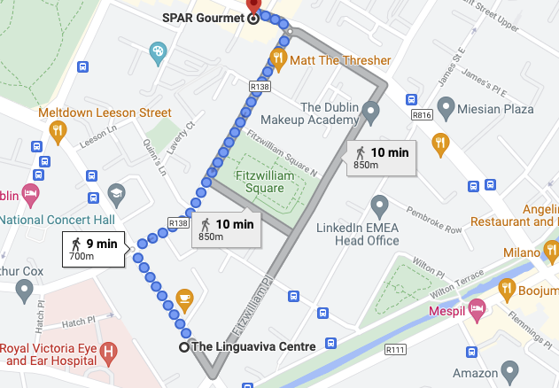
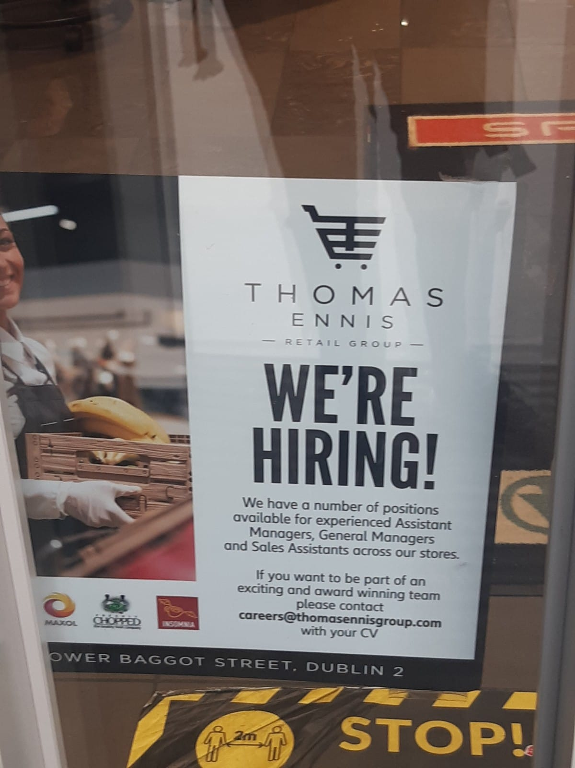
SPAR GOURMET
138 Lower Baggot Street, Dublin Southside, Dublin 2
+353 1 6612540

Slide 11
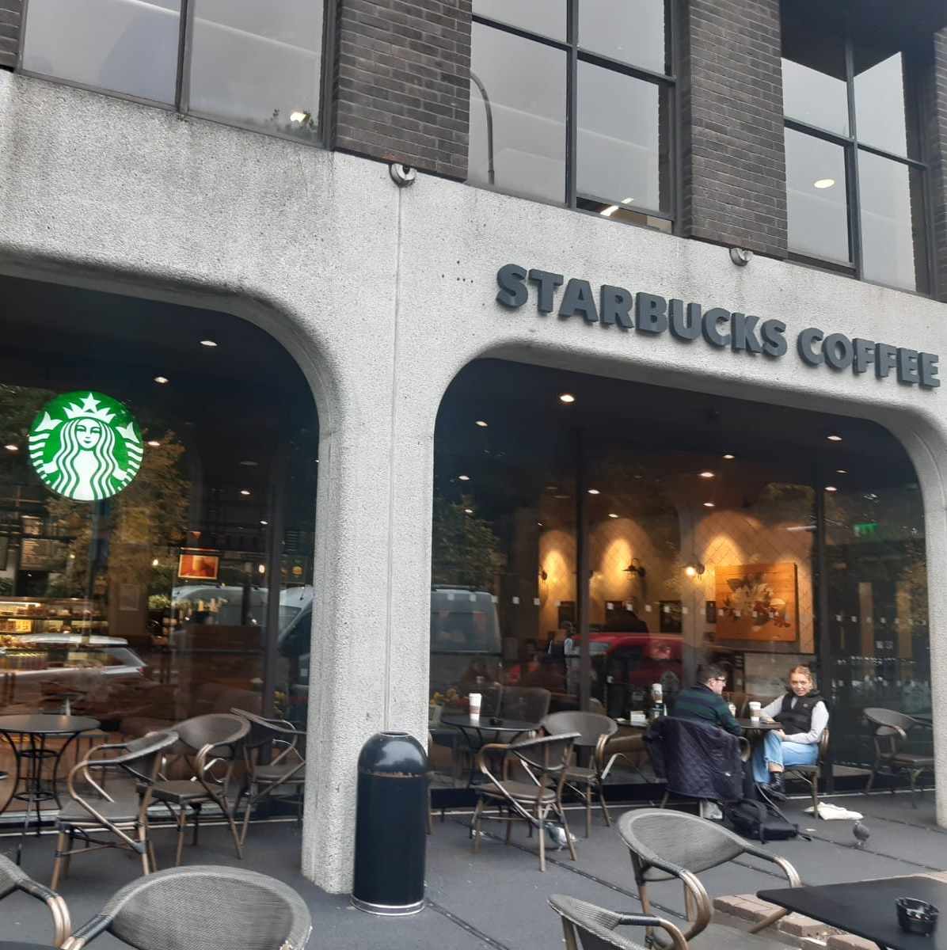
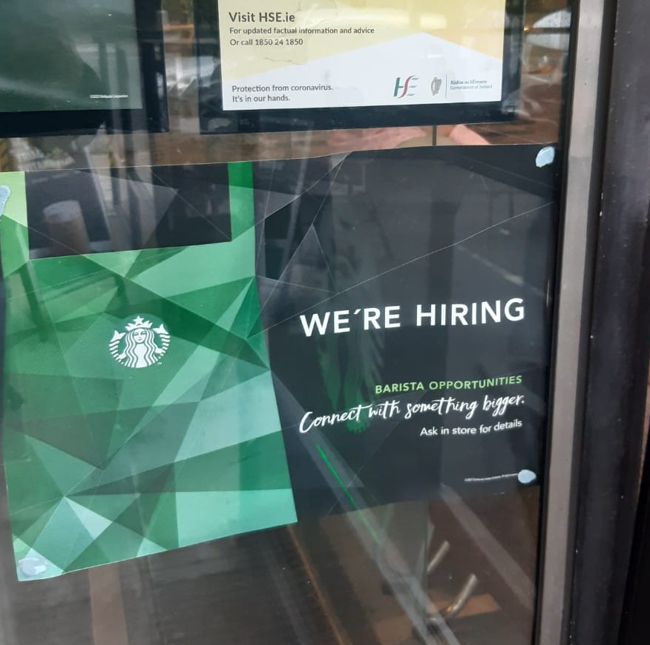
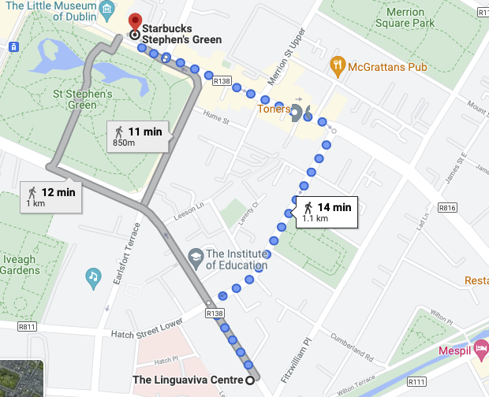
STARBUCKS COFFEE
Stephen Court, GF1, St Stephen's Green, Dublin 2
+353 1 6788887

Slide 12

The “post-pandemic” job market seems to be growing and as businesses become viable again more and more such opportunities will arise.
ALWAYS keep an eye out for such posts and make sure to take a quick picture so you can share the details with classmates.

